Slide 1

DSCI551 Course Project
2024 April 17
RateMyBeer
A Distributed Data Management System of Beer Data
TEAM 61
Haoran Wang
Xintong Jiang
Rahul Aggarwal

Slide 2
Project Overview
A distributed, robust, fast data management system for beer rating data.
It allows users to manage their beer data on the website, including insert, update, query and delete.
It also provides some analysis results of current beer reviews. (NOT DONE YET!!!)
It adopts UUID (Universally Unique Identifier) for global primary key uniqueness, and uses a hash function to map a UUID to a database.
picture
TEAM 61
2

Slide 3
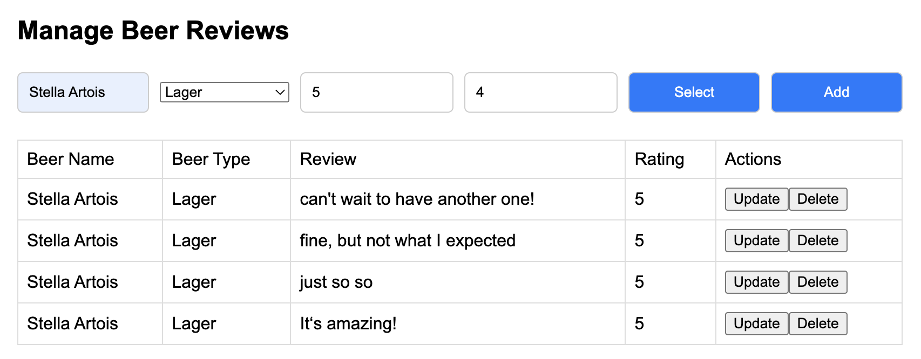
Website features
1
2
Real-time CRUD options
Current beer data analysis
picture
picture
TEAM 61
3

Slide 4
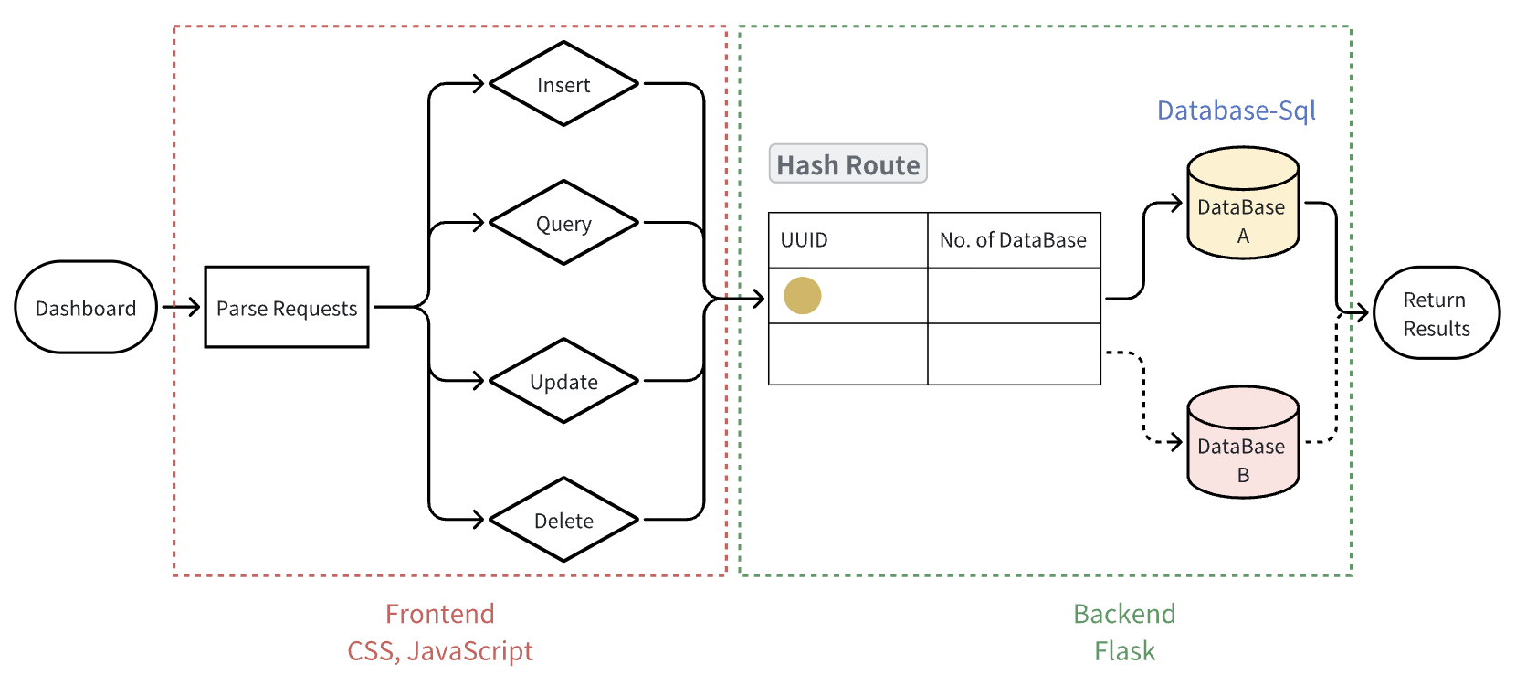
Technical Architecture
TEAM 61
4

Slide 5
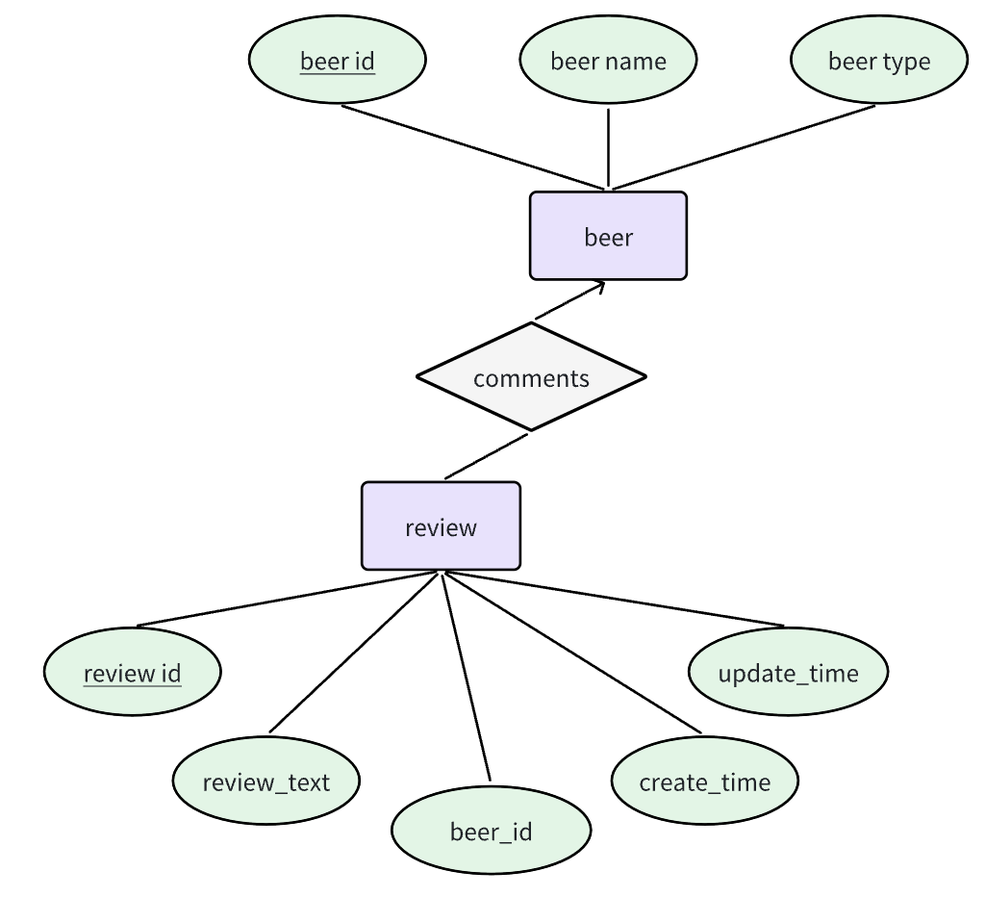
Dataset Preparation
Our data comes from Beer Data Analytics^{[1]} in Kaggle.
The raw dataset contains different types of beers and various rating aspects, with a total of 13 attributes and 528,870 pieces of data items.
We use part of the attributes and split them into two tables.
Beer
| beer_id | beer_name | beer_type |
Review
| review_id | review_text | create_time | update_time | beer_id |
TEAM 61
5
Notes:
[1] https://www.kaggle.com/datasets/gauravharamkar/beer-data-analytics?select=BeerProject.csv

Slide 6
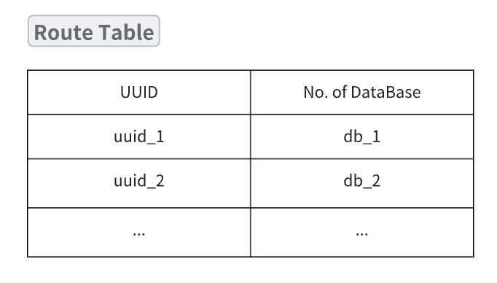
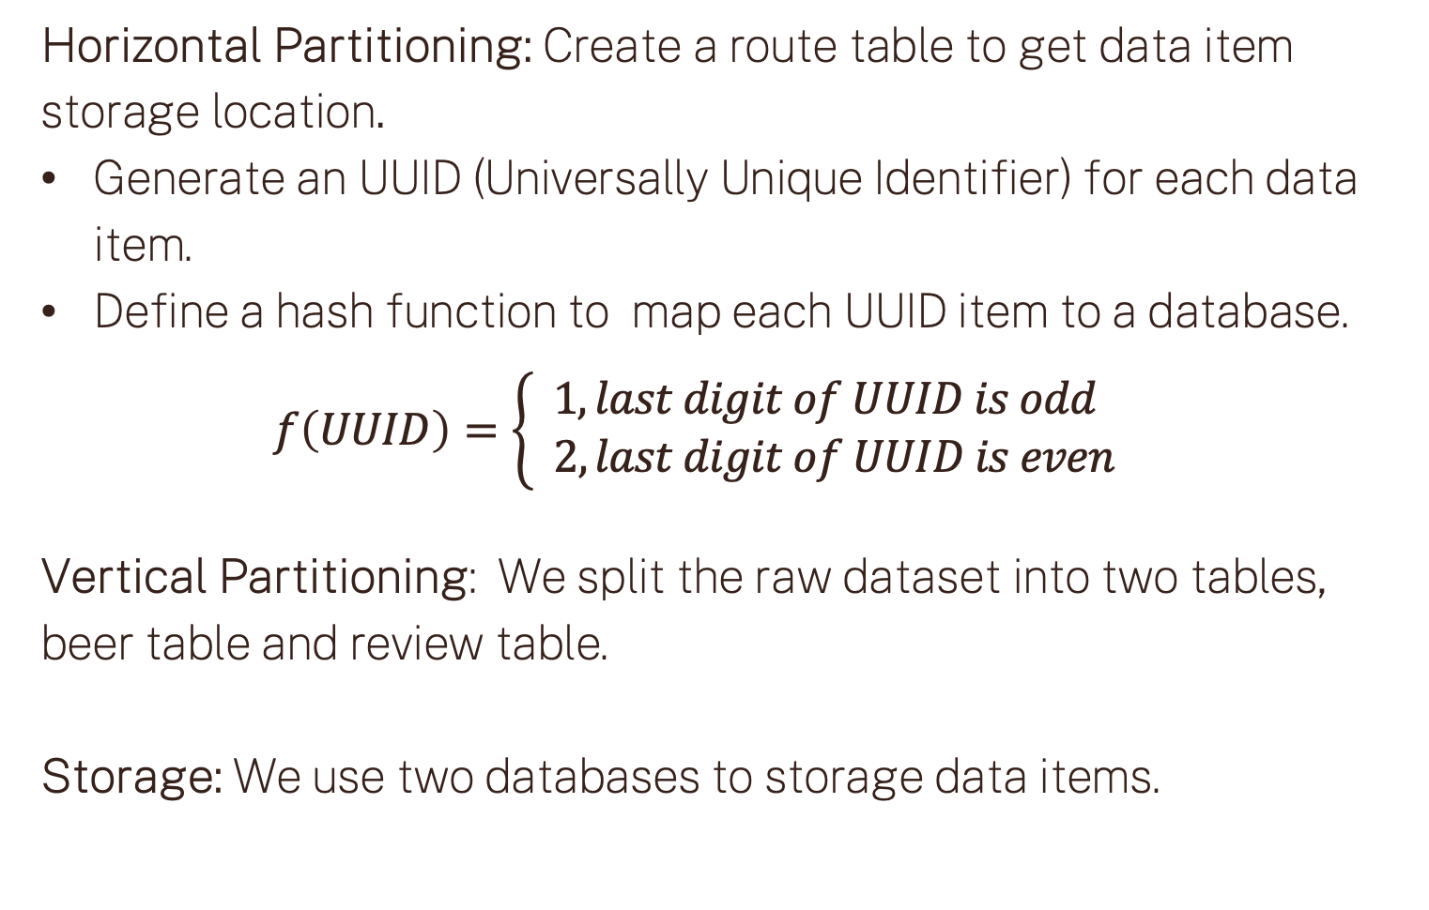
Distributed DataBase Design
Partition & Storage
Horizontal Partitioning: Create a route table to get data item storage location.
Generate an UUID (Universally Unique Identifier) for each data item.
Define a hash function to map each UUID item to a database.
$$f\left(UUID\right)=\left\{\begin{aligned}1, last digit of UUID is odd \\ & 2, last digit of UUID is even\end{aligned}\right.$$
Vertical Partitioning: We split the raw dataset into two tables, beer table and review table.
Storage: We use two databases to storage data items.
TEAM 61
6
Notes:
Hash key: uuid
Hash value: db

Slide 7
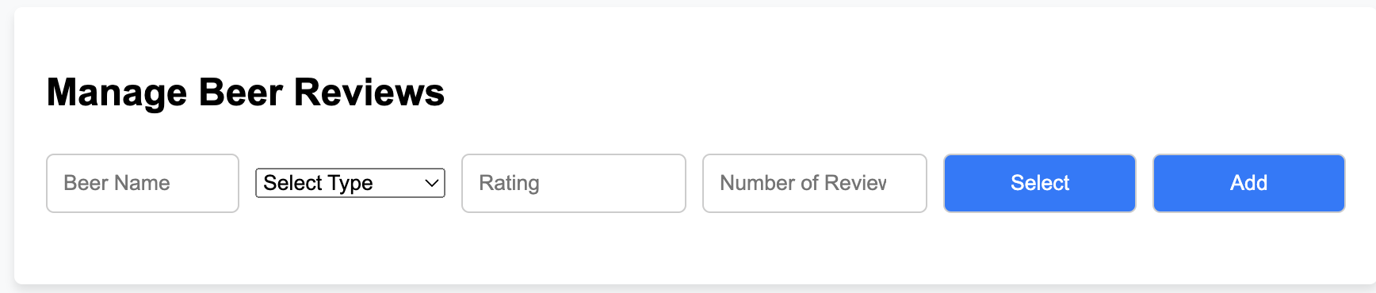
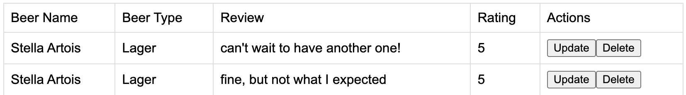
User interface and applications
Manage the data through insert, query, update and delete.
Picture C
Picture R
Picture U
Picture D
TEAM 61
8

Slide 8
User interface and applications
Analysis results of current beer reviews. (NOT DONE YET!!!)
Picture
TEAM 61
9

Slide 9
DSCI551 Course Project
2024 April 17
THANK YOU
For Listening
TEAM 61
Haoran Wang
Xintong Jiang
Rahul Aggarwal

